Slide 1
ME 165
Basic Mechanical Engineering
Lecture 11
Kinematics of Rigid Bodies
Sadia Tasnim
Lecturer
Department of Mechanical Engineering, BUET

Slide 2
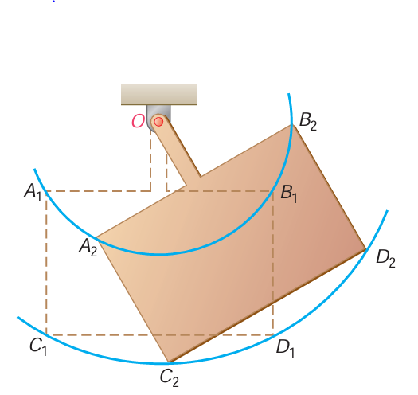
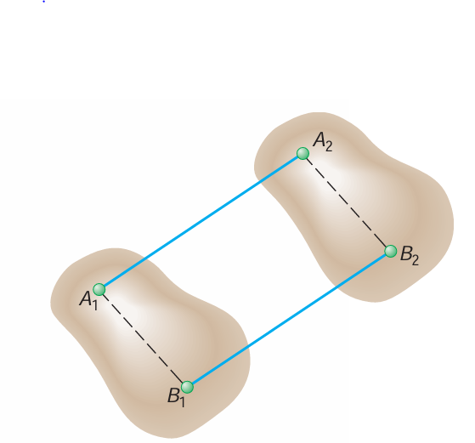
Kinematics of Rigid Bodies
4
Translation
Rotation About a Fixed Axis

Slide 3
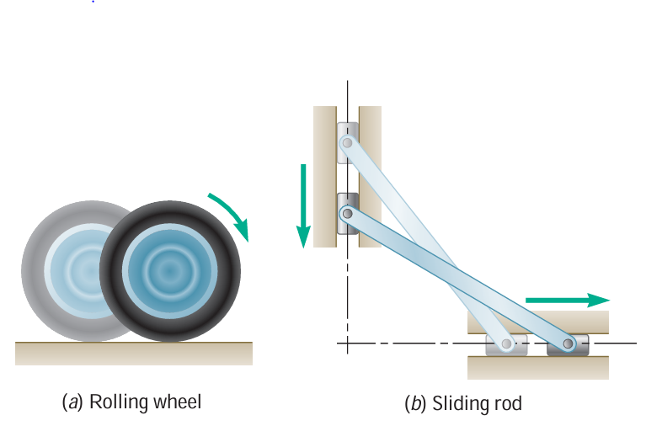
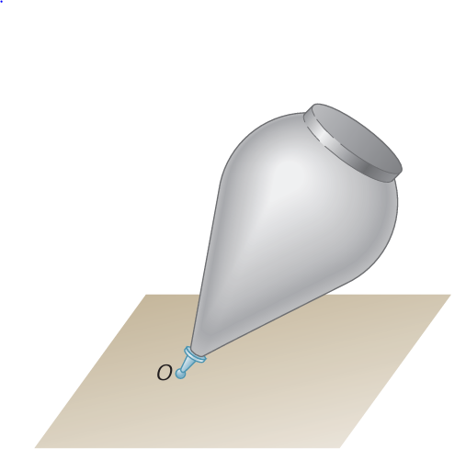
Kinematics of Rigid Bodies
4
General Plane Motion
Motion About a Fixed Point

Slide 4
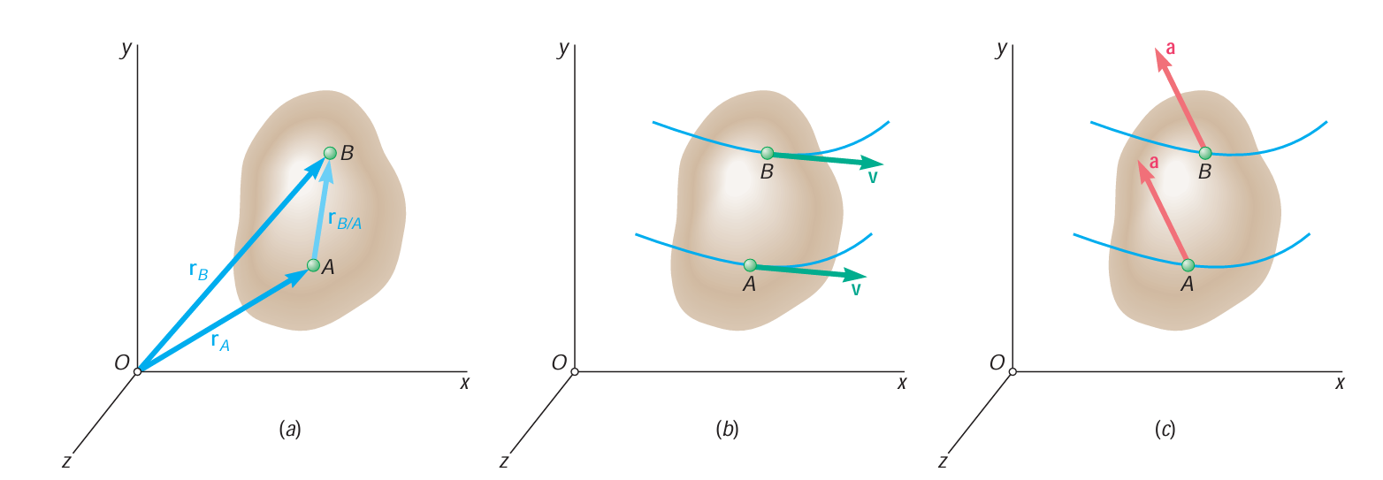
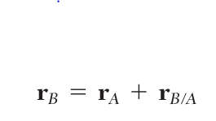
A Rigid Body In Translation
When a rigid body is in translation, all the points of the body have the same velocity and the same acceleration at any given instant
r_{B/A} : constant direction & constant magnitude

Slide 5
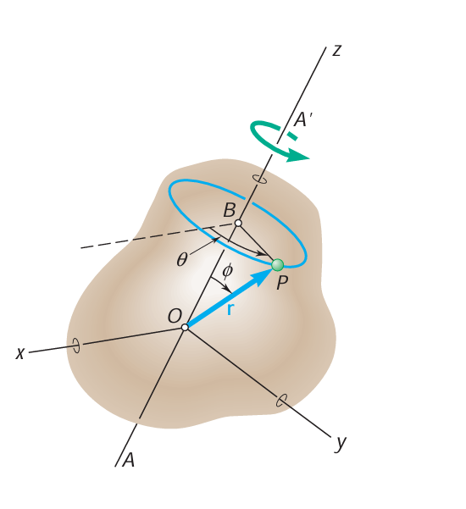
Rotation About a Fixed Axis
4

Slide 6
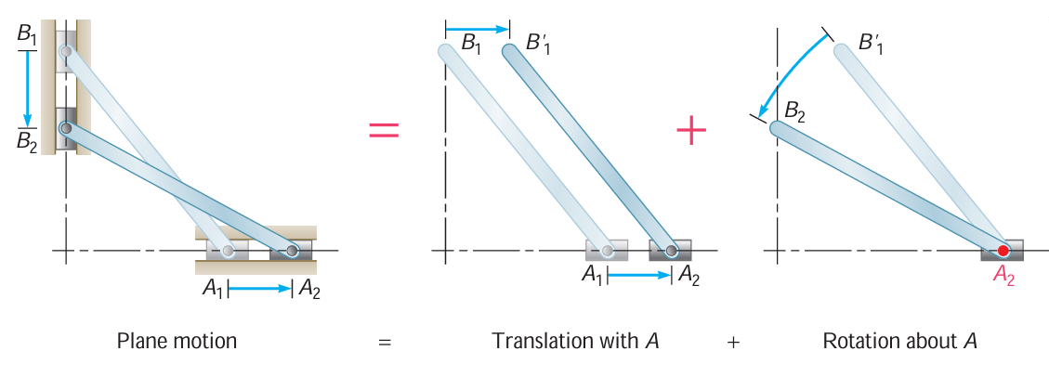
General Plane Motion

Slide 7
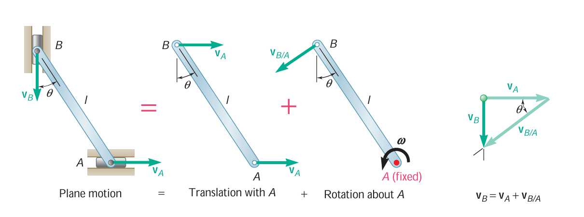
General Plane Motion

Slide 8
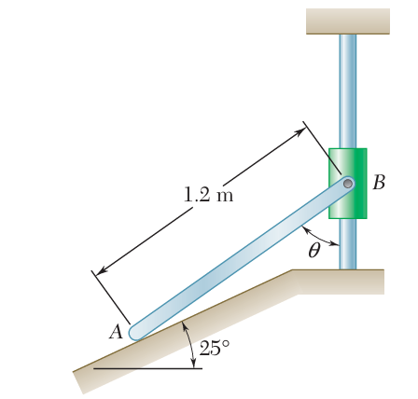
Kinematics
12
Problem:
Collar B moves upward with a constant velocity of 1.5 m/s. At the instant when Ө = 50°, determine (a) the angular velocity of rod AB, (b) the velocity of end A of the rod.

Slide 9
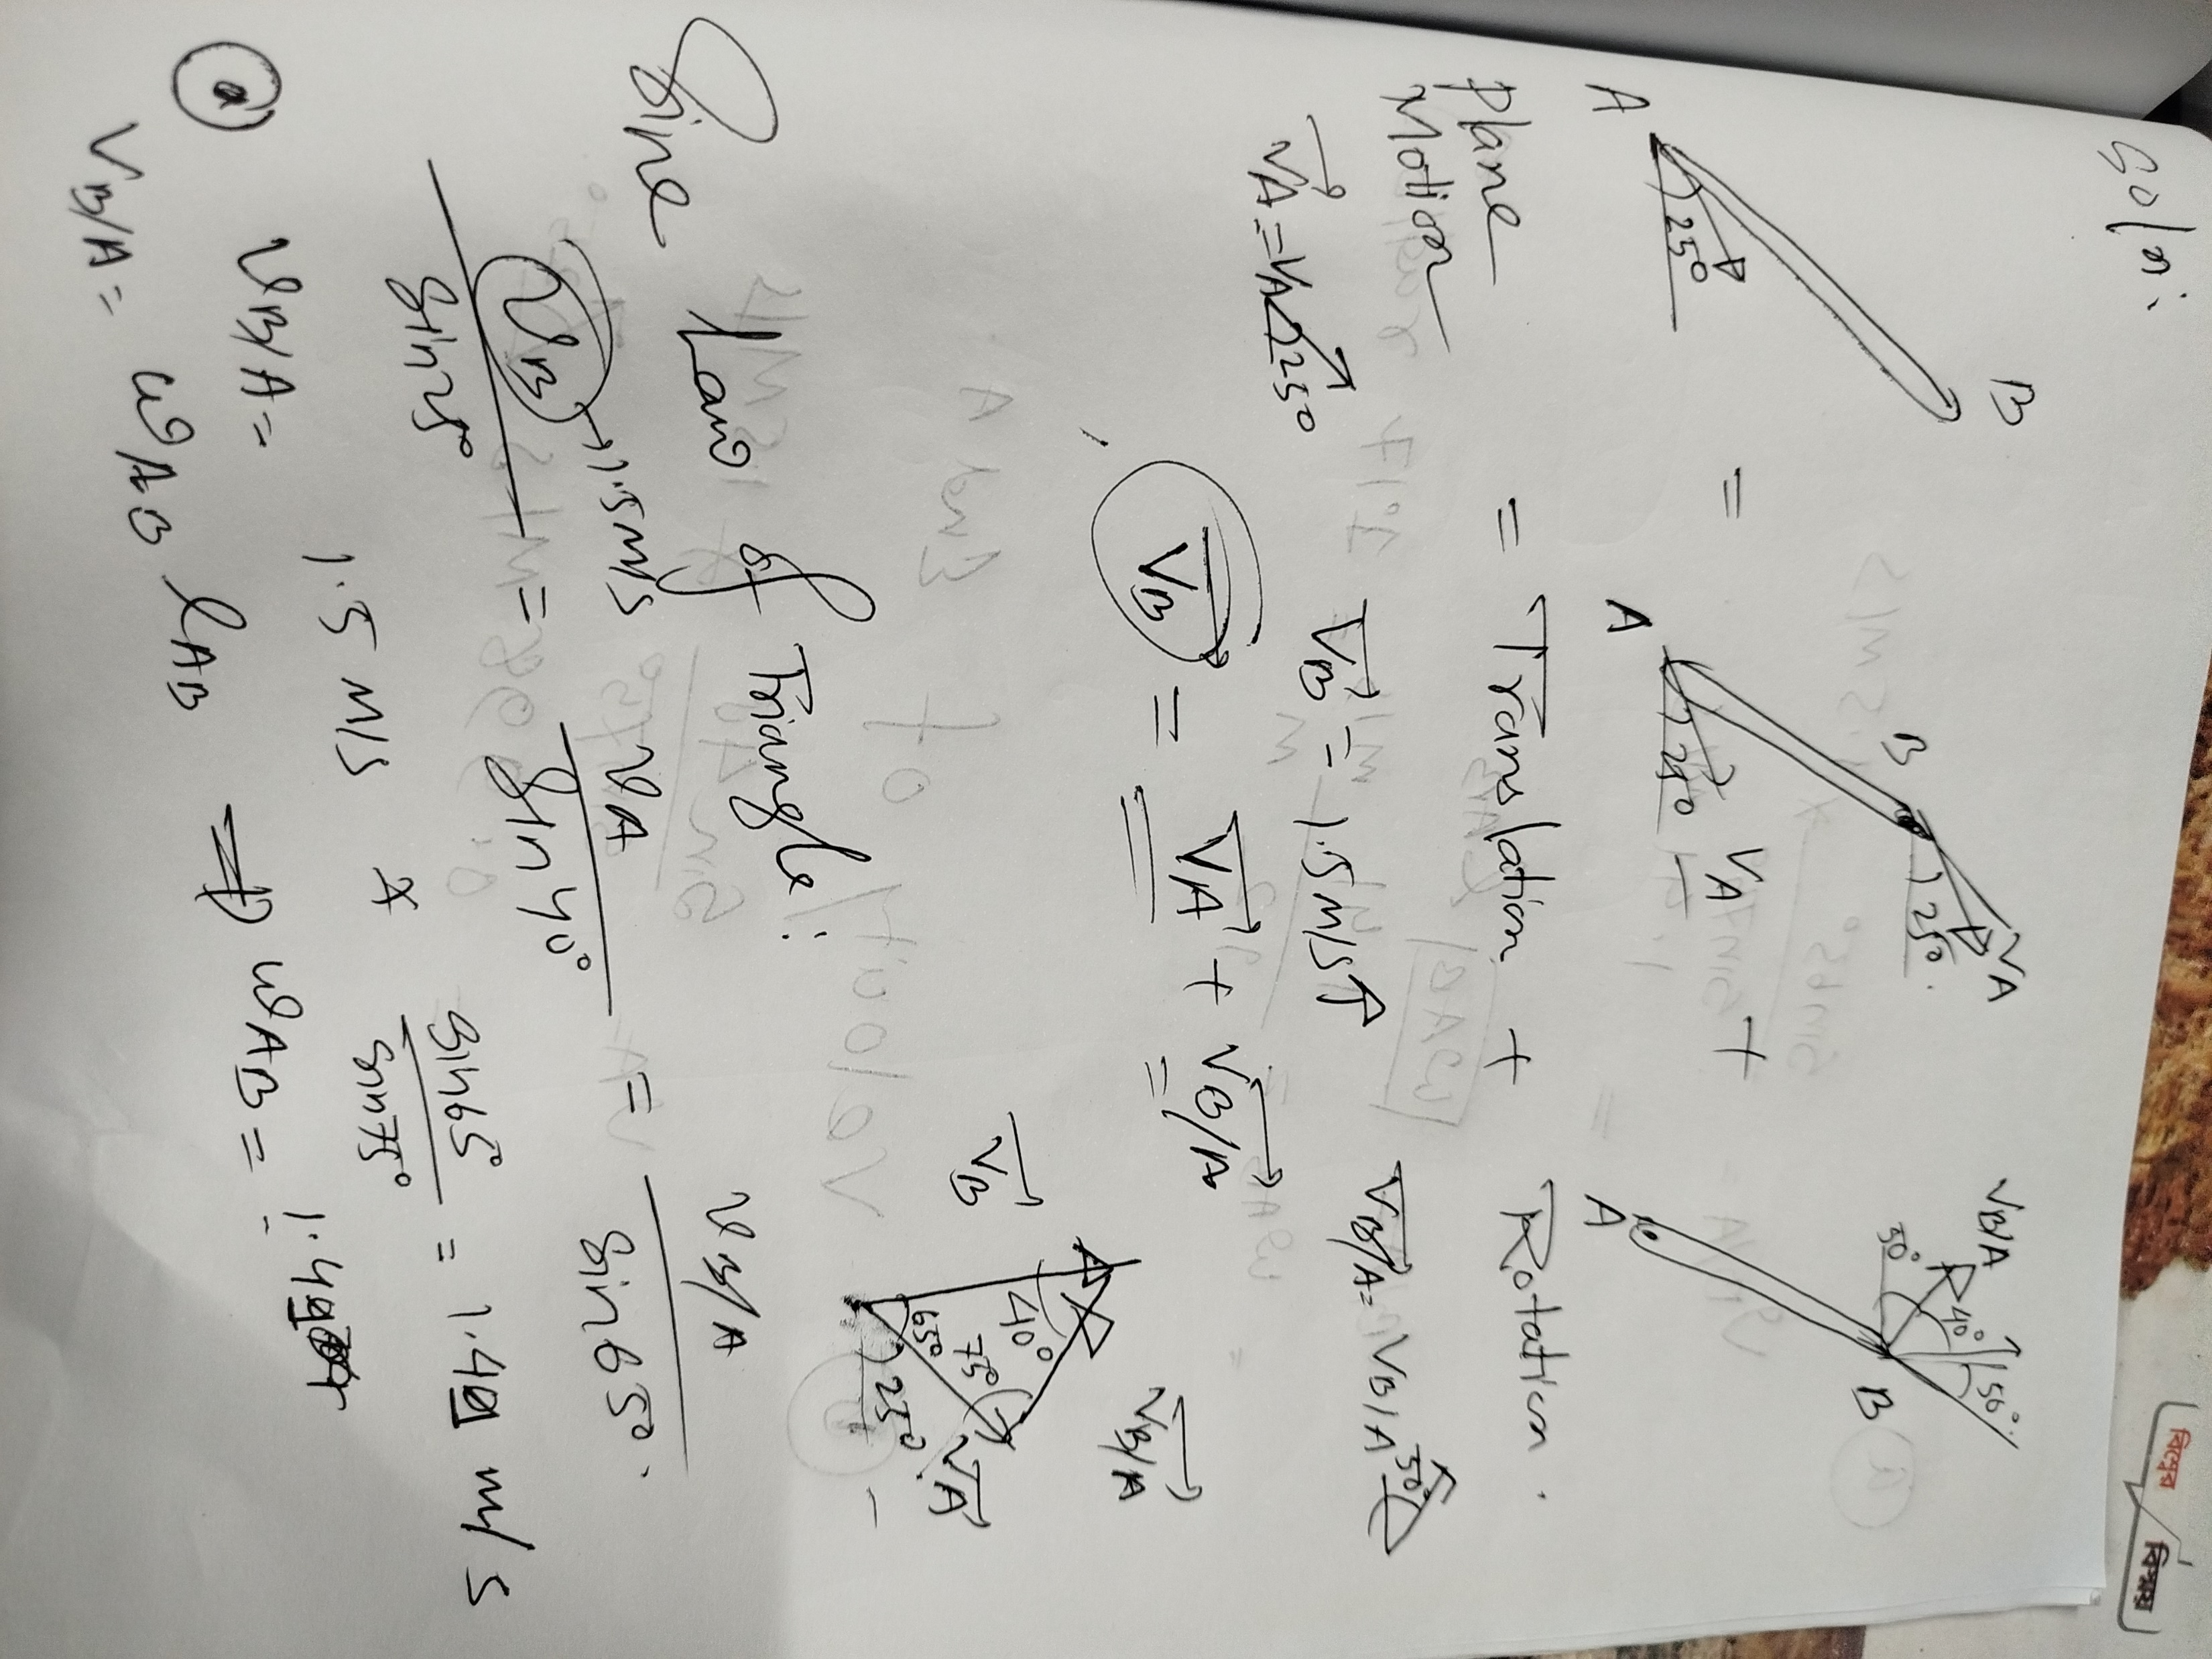
Solution:
12

Slide 10
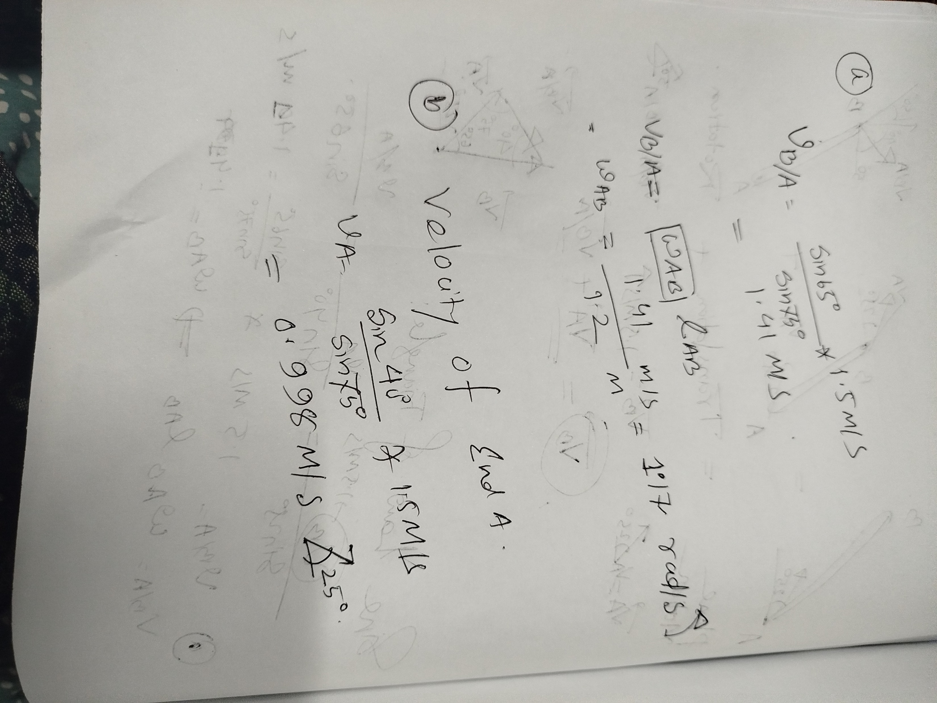
Solution:
12

